Slide 1

Message Routing
Systems Integration
PBA Softwareudvikling/BSc Software Development
Tine Marbjerg
Fall 2017
Message Routing

Slide 2

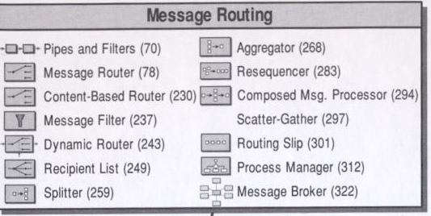
Overview of Message Routing in EIP chap 7
Message Routing

Slide 3

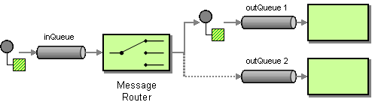
Message Router (78)
Decouples a message source from the ultimate destination of the message
Is the filter component in the Pipes and Filters architecture
  Republishes message on different channel depending on condition
Message Routing

Slide 4
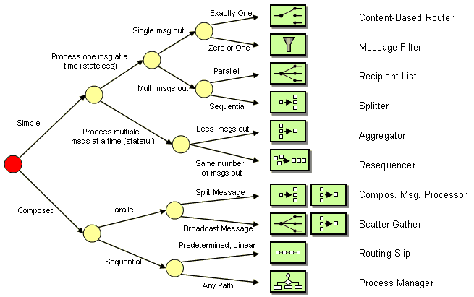
Right Router for the Right Purpose (EIP p. 229)
How to read the diagram? Examples:
  If you are looking for a simple routing pattern that consumes one message at a time but publishes multiple messages in sequential order, you should use a Splitter.
  The diagram also illustrates how closely the individual patterns are related. For example, a Routing Slip and a Process Manager solve similar problems while a Message Filter does something rather different.

Slide 5
Right Router for the Right Purpose
How to read the diagram? Examples:
  If you are looking for a simple routing pattern that consumes one message at a time but publishes multiple messages in sequential order, you should use a Splitter.
  The diagram also illustrates how closely the individual patterns are related. For example, a Routing Slip and a Process Manager solve similar problems while a Message Filter does something rather different.

Slide 6
Right Router for the Right Purpose
How to read the diagram? Examples:
  If you are looking for a simple routing pattern that consumes one message at a time but publishes multiple messages in sequential order, you should use a Splitter.
  The diagram also illustrates how closely the individual patterns are related. For example, a Routing Slip and a Process Manager solve similar problems while a Message Filter does something rather different.

Slide 7
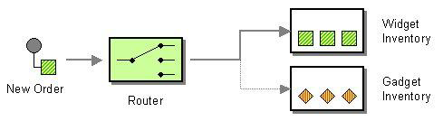
Content-Based Router (230)
Use a Content-Based Router to route each message to the correct destination based on the content of the message
The routing can be based on a number of criteria such as existence of fields, specific field values, configuration rules engine etc.
Message Routing
Notes:
Sometimes an implementation of a single logical function is spread across multiple physical systems, like in example above, but the sending application doesn’t need to know that.

Slide 8

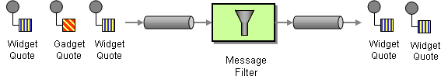
Message Filter (237)
How can a component avoid receiving uninteresting messages?
Use a special Message Router called a Message Filter to remove undesired messages from a channel based on a set of criteria
A special case of Content-Based Router where a message might be discarded (null channel) if message content doesn’t match criteria
Message Routing

Slide 9
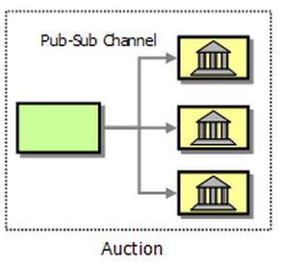
Example of Filtering in Loan Broker (chapter 9)
Sending loan requests to a number of banks by auction:
Using a Publish-Subscribe Channel broadcasts a loan request to all subscribing banks and lets each bank determine which requests to service.
Each bank can use a Message Filter to filter out undesirable loan requests.
Consequence?
  Leaves the loan broker pretty much maintenance free in case of adding or removing banks but it requires more work on the side of the banks.
Message Routing

Slide 10
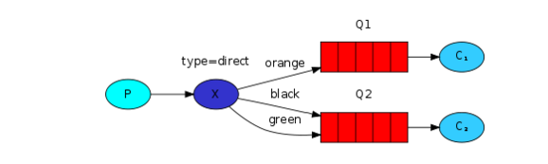
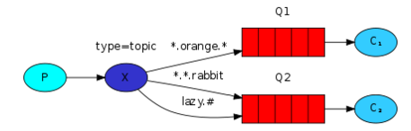
Filtering Functions Built into Messaging Systems
Messaging Filter functions in RabbitMQ:
Direct exchange:
Topic exchange (routing based on multiple criteria)
Message Routing

Slide 11
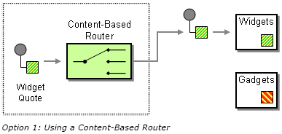
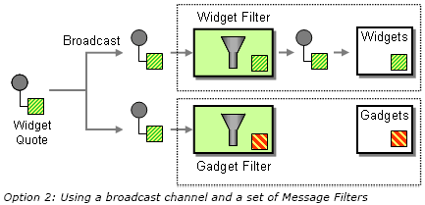
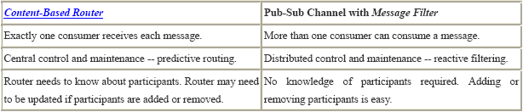

Content-Based Router or Message Filter?
Message Routing

Slide 12

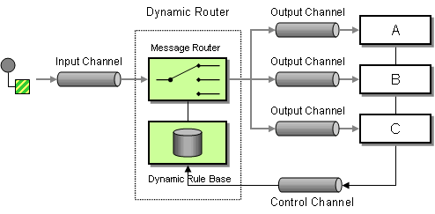
Dynamic Router (243)
How can you avoid the dependency of the router on all possible destinations while maintaining its efficiency?
Use a Dynamic Router that can self-configure based on special configuration messages from participating destinations
In basic scenario, each participant announces it existence and routing preferences to the Dynamic Router at startup time
  Participants must know control queue
  Dynamic router must store rules in persistent way
  Because recipients are independent from each other, the dynamic router has to deal with rule conflicts
Message Routing

Slide 13

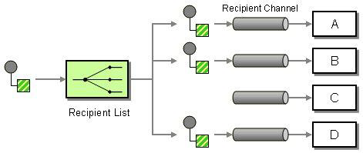
Recipient List (249)
How do we route a message to a dynamic list of recipients?
Define a channel for each recipient. Then use a Recipient List to inspect an incoming message, determine the list of desired recipients, and forward the message to all channels associated with the recipients in the list.
Message Routing

Slide 14
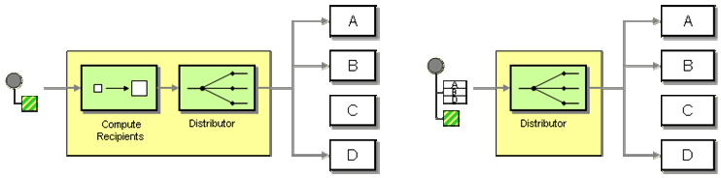
Recipient List – How it works
Compute a list of recipients
Traverse the list and send a copy of the received message to each recipient
OBS! A Recipient list can compute the recipients (left) or have another (external) component provide a list (right)
A robust implementation must be able to process the incoming message, but only ”consume” it after all outbound messages have been successfully sent.
Message Routing
Notes:
Like a Content-Based Router, the Recipient List usually does not modify the message contents

Slide 15
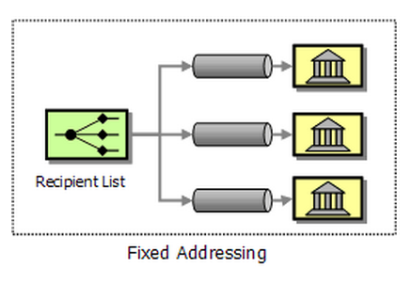
Example 1 in Loan Broker (chapter 9)
Fixed addressing: The list of banks is hard-coded (no dynamic list of receivers).
Message Routing

Slide 16
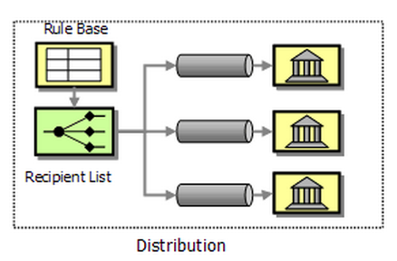
Example 2 in Loan Broker (chapter 9)
Distribution: The loan broker maintains criteria on which banks are good match for specific request
Pros
Broker has more control over involved banks (more efficient by reducing no. of requests)
Broker can prefer certain banks based on business relationship
Cons
Additional business logic is needed in broker (more maintainance than pub-sub)
Separate messages channels for each participant in order to control message flow
Message Routing

Slide 17
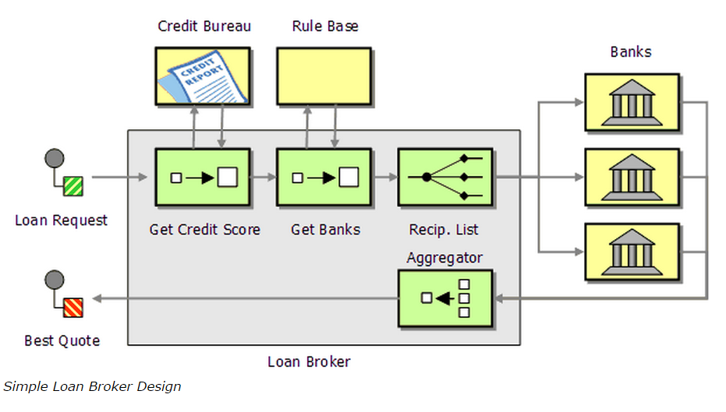
Computation of recipients
Message Routing

Slide 18

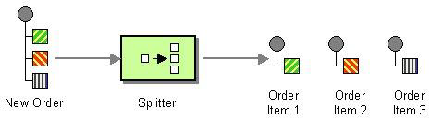
Splitter (259)
How can we process a message if it contains multiple elements, each of which may have to be processed in a different way?
Use a Splitter to break out the composite message into a series of individual messages, each containing data related to one item
Message Routing

Slide 19

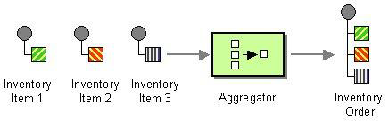
Aggregator (268)
How do we combine the results of individual, but related messages so that they can be processed as a whole?
Use a stateful filter, an Aggregator, to collect and store individual messages until it receives a complete set of related messages. Then, the Aggregator publishes a single message distilled from the individual messages
Message Routing

Slide 20
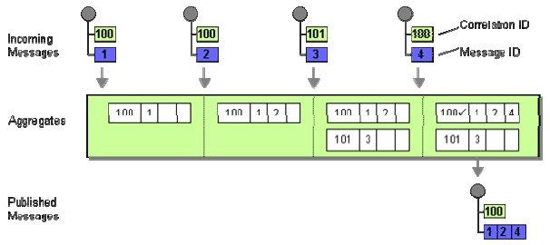
Design of Aggregator
Correlation: Which messages belong together
Completeness Condition: When to publish the result
Aggregation Algorithm: How to combine the received messages into a single result message
Message Routing

Slide 21
Completeness Condition
Possible aggregator completeness conditions:
Wait for all – all responses received
Timeout – wait only specified length of time
First Best – Wait until the first (fastest) response is received
Timeout with Override – wait specified time of length or until message with preset minimum score is received
External Event – typically external business event
Message Routing

Slide 22
Aggregation Algorithm
Possible aggregator algorithms:
Select ”best” answer (e.g. best bid)
Condense data (e.g. average value)
Collect data for later evaluation (individual messages’ data are compiled into single message)
Message Routing

Slide 23
Example of aggregation in Loan Broker chapter 9
Aggregating Strategies: Multiple Channels vs. Single Channel
You can have all banks submit their responses to a single response channel or you can have a separate response channel for each bank.
A single channel reduces the maintenance burden of setting up a separate channel for each participating bank, but requires:
  each bank reply message to include a field identifying the bank who issued the quote.
  the Aggregator must know how many response messages to expect (unless the Recipient List passes this information to the Aggregator (we call this an Initialized Aggregator).
Message Routing

Slide 24
Example of aggregation in Loan Broker chapter 9
2. If we use an auction-style Publish-Subscribe Channel the number of possible responses is unknown to the loan broker so that the Aggregator has to employ a completeness condition that does not depend on the total number of participants.
For example, the Aggregator could simply wait until it has a minimum of three responses. But even that would be risky if temporarily only two banks participate. In that case, the Aggregator could time out and report that it received an insufficient number of responses.
Message Routing

Slide 25

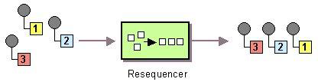
Resequencer (127)
How can we get a stream of related but out-of-sequence messages back into the correct order?
Use a stateful filter, a Resequencer, to collect and re-order messages so that they can be published to the output channel in a specified order
Message Routing

Slide 26
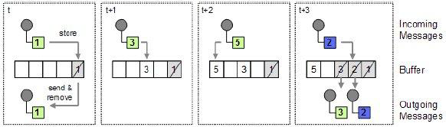
Internal Operation of the Resequencer
Out-of-sequence messages stores (buffer) until all the “missing” messages are received
When the buffer contains a consecutive sequence it sends this to the output channel
Example: in-coming sequence: 1, 3, 5, 2
Message Routing

Slide 27
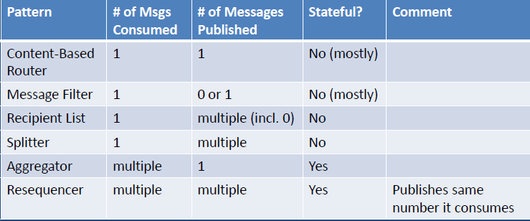
Message Router Variants
Message Routing
Notes:
Any router can be implemented as a dynamic variant –Dynamic Router (243)

Slide 28

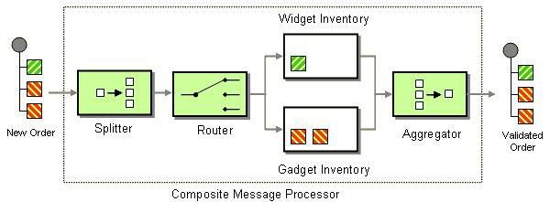
Composed Message Processor (294)
= Splitter + Router + Aggregator
Message Routing

Slide 29
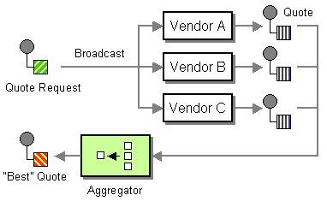
Scatter-Gather (297)
A Scatter-Gather broadcasts a message to multiple recipients and re-aggregates the responses back into a single message
Message Routing

Slide 30
Scatter-Gather in Loan Broker chapter 9
Two variants:
Distribution via Recipient List
Auction-style via Publish-Subscribe Channel
Notice that solution is different from Composed-Message Processor:
Instead of a splitter, we broadcast the complete message to all involved parties.
Message Routing

Slide 31

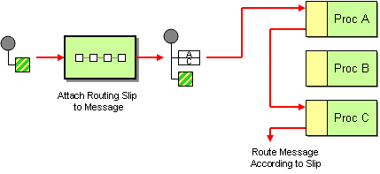
Routing Slip (301)
How do we route a message consecutively through a series of processing steps when the sequence of steps is not known at design time and may vary for each message?
Attach a Routing Slip to each message, specifying the sequence of processing steps. Wrap each component with a special message router that reads the Routing Slip and routes the message to the next component in the list.
Message Routing

Slide 32

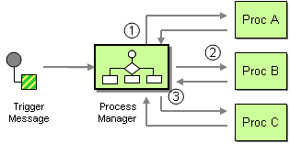
Process Manager (312)
How do we route a message through multiple processing steps when the required steps may not be known at design time and may not be sequential?
Use a central processing unit, a Process Manager, to maintain the state of the sequence and determine the next processing step based on intermediate results
Process modeling is design of workflow activity / business process management
Message Routing

Slide 33
Process Manager - alternatives
Process Manager is hub-and-spoke pattern.
Multiple Content-Based Routers
Pro – maxmimum flexibility
Con – routing logic is spread across many routing components
Routing Slip
Pro - Central point of control (computing message path up front)
Con – Cannot reroute based on intermediate results or execute multiple steps simultaneously
Message Routing

Slide 34

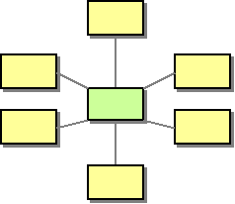
Message Broker (322)
How can you decouple the destination of a message from the sender and maintain central control over the flow of messages?
Use a central Message Broker that can receive messages from multiple destinations, determine the correct destination, and route the message to the correct channel.
Hub-and-spoke architectural style
  Message Broker isn’t monolithic component. Internally, it
  uses the design patterns presented in Routing chapter.
  RabbitMQ is message broker
Message Routing
Notes:
Commercial tools have built-in endpoint code
Developer doesn’t have to write transport-related code (to send and receive messages to and from the message bus)

Slide 35
Message Broker Tools
Typically:
Built-in endpoint code
  Client API for send & receive messages → The developer doesn’t have to write transport-related code
Visual design tools
  Visual components such as routers, decision points, transformers
Runtime support
  Monitoring traffic flowing through the broker
Message Routing
Notes:
Commercial tools have built-in endpoint code
Developer doesn’t have to write transport-related code (to send and receive messages to and from the message bus)

Slide 36
Visual design Tool Exercise
RabbitMQ Simulator - how does it work?
Resources
  https://vimeo.com/56986242
  http://blogs.vmware.com/vfabric/2013/03/introducing-the-rabbitmq-simulator-video-open-source-bits.html
Message Routing

